Slide 1


Sentimental Analysis on YouTube
Sameera Turupu Aditya Bhamidipati
Master’s Computer Science
Georgia State University

Slide 2


Introduction
world’s largest video sharing platform
irrelevant results based on likes and views
Comments play a active role to the actual polarity
Search results are title and tag based

Slide 3
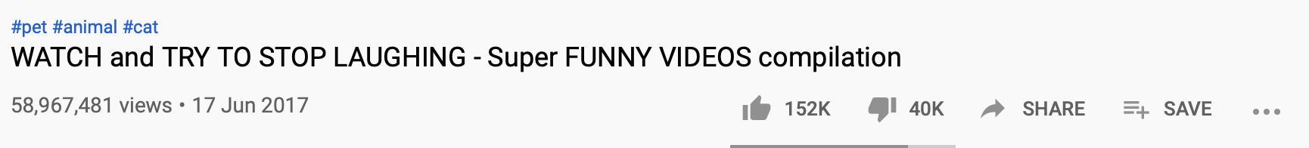
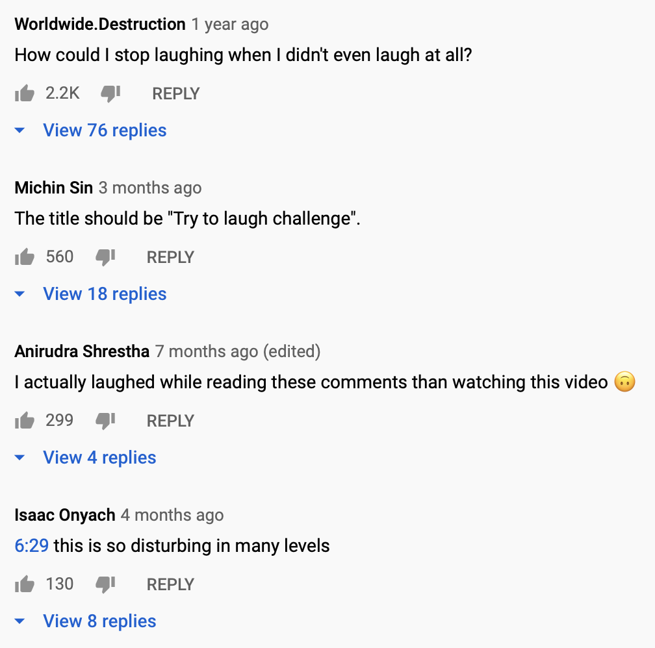
Motivation
Likes can be misleading which is why comments are also necessary for determining the polarity of a video
Tag is another measure of how popular a video is.
E.g., #funny, #dogs, #crazy

Slide 4

Next Steps
Input description
Exploratory data analysis
Data Preprocessing
Architecture
Comment analysis
Data pipeline
Tag analysis
Collaborations

Slide 5
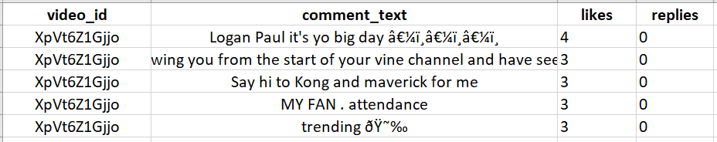
Data description
Rows: ~50000
Source: https://www.kaggle.com/datasnaek/youtube-new

Slide 6
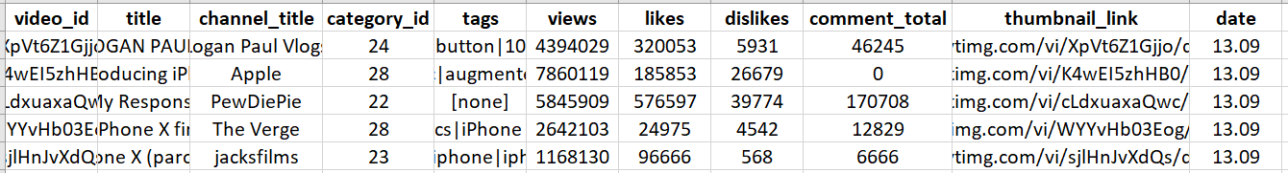
Data description contd..
Rows: ~50000
Source: https://www.kaggle.com/datasnaek/youtube-new

Slide 7
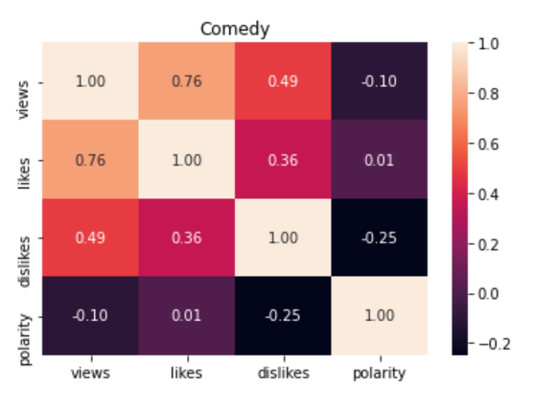
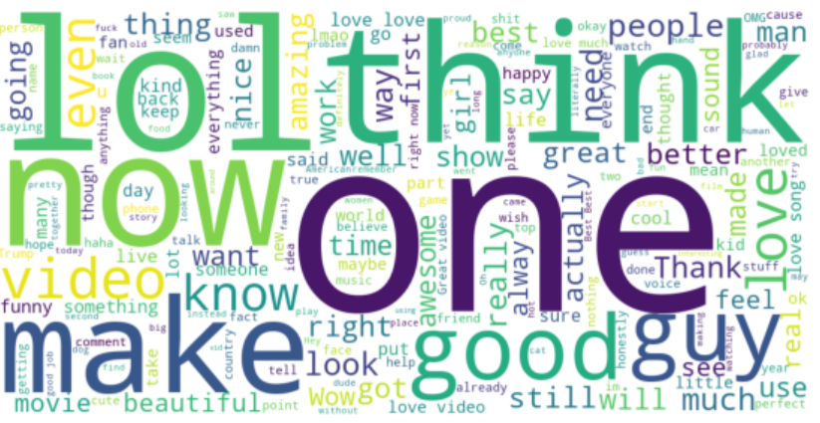
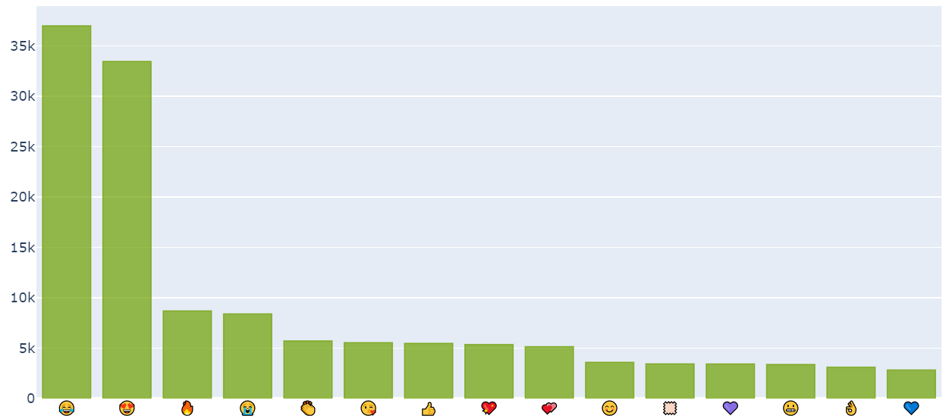

Exploratory data analysis

Slide 8
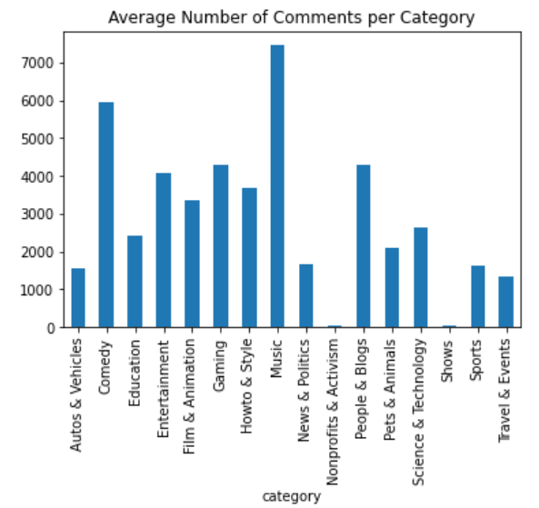
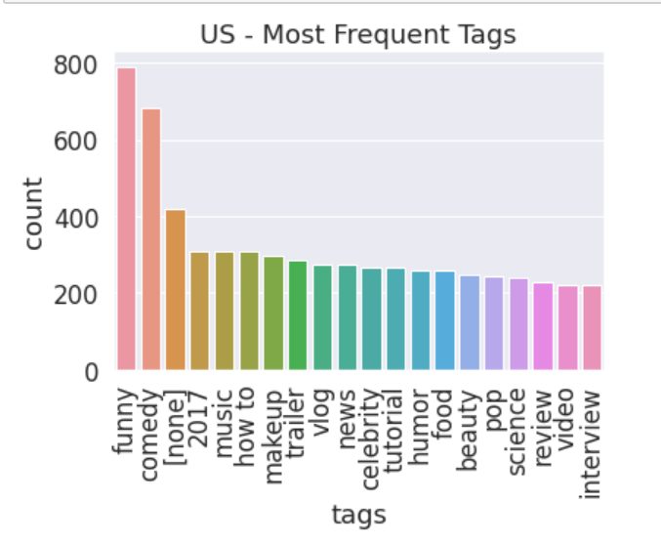
Exploratory data analysis contd..

Slide 9





Technology Stack

Slide 10
Data preprocessing
Removing Punctuations, Numbers and Special Characters
Removing Short Words
Changing the text to lowercase
Tokenization - “This is a sample” -> [“This”, “is”, “a”, “sample”]
Lemmatization - example: “singing” -> “sing”

Slide 11
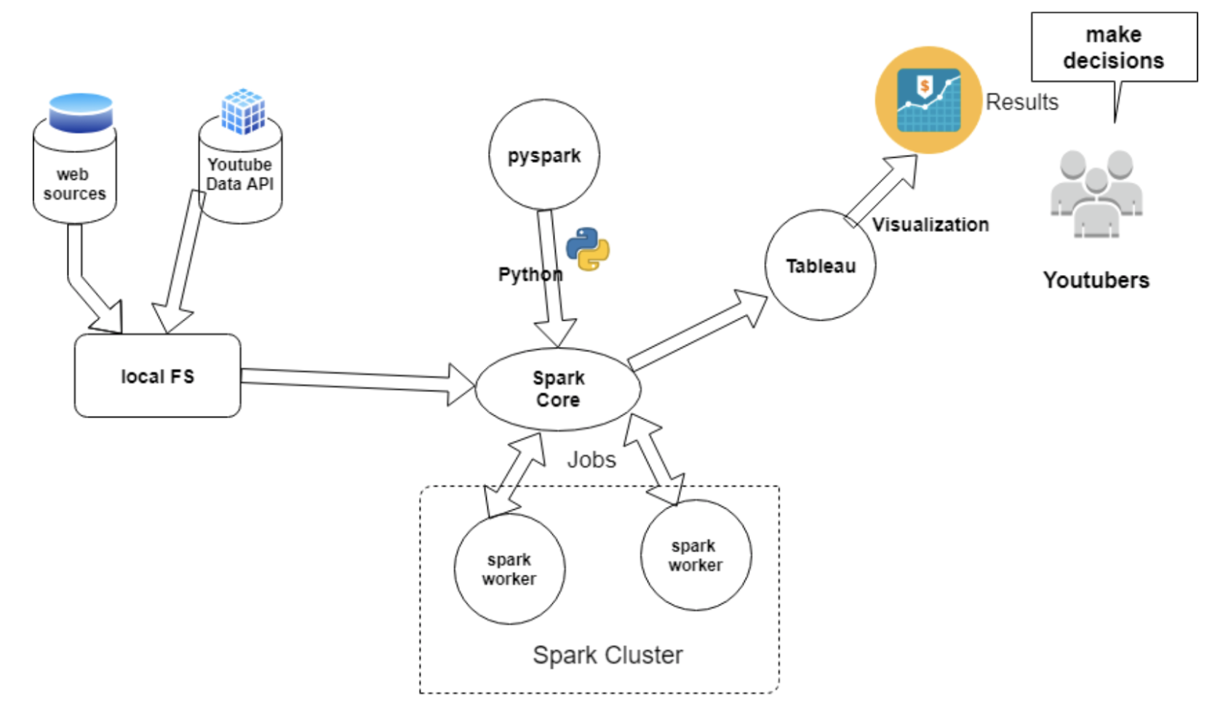
Architecture

Slide 12
Comment analysis
Input - Preprocessed data
TextBlob for finding the polarity of comments in RDD
Aggregated the total comments, likes, views and dislikes for a video using Spark SQL
Applied Logistic Regression on analyzed data using Spark ML
StringIndexer - label encoding
OneHotEncoderEstimator - categorical value represents the numerical value of the entry in the dataset.
VectorAssembler - takes multiple columns as input and outputs a single column
Accuracy - ~79%

Slide 13
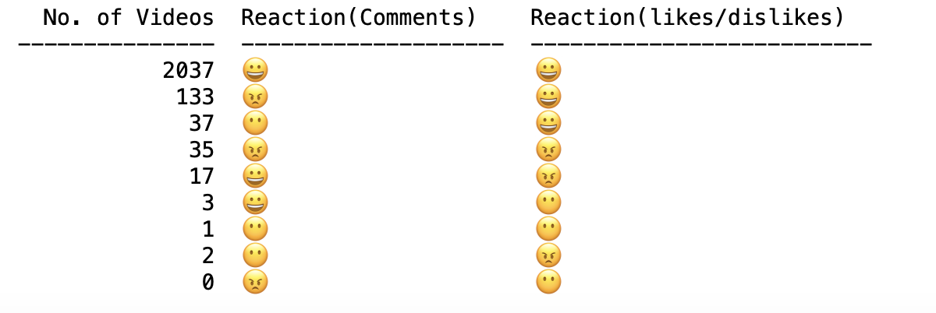
Comment Analyis results

Slide 14
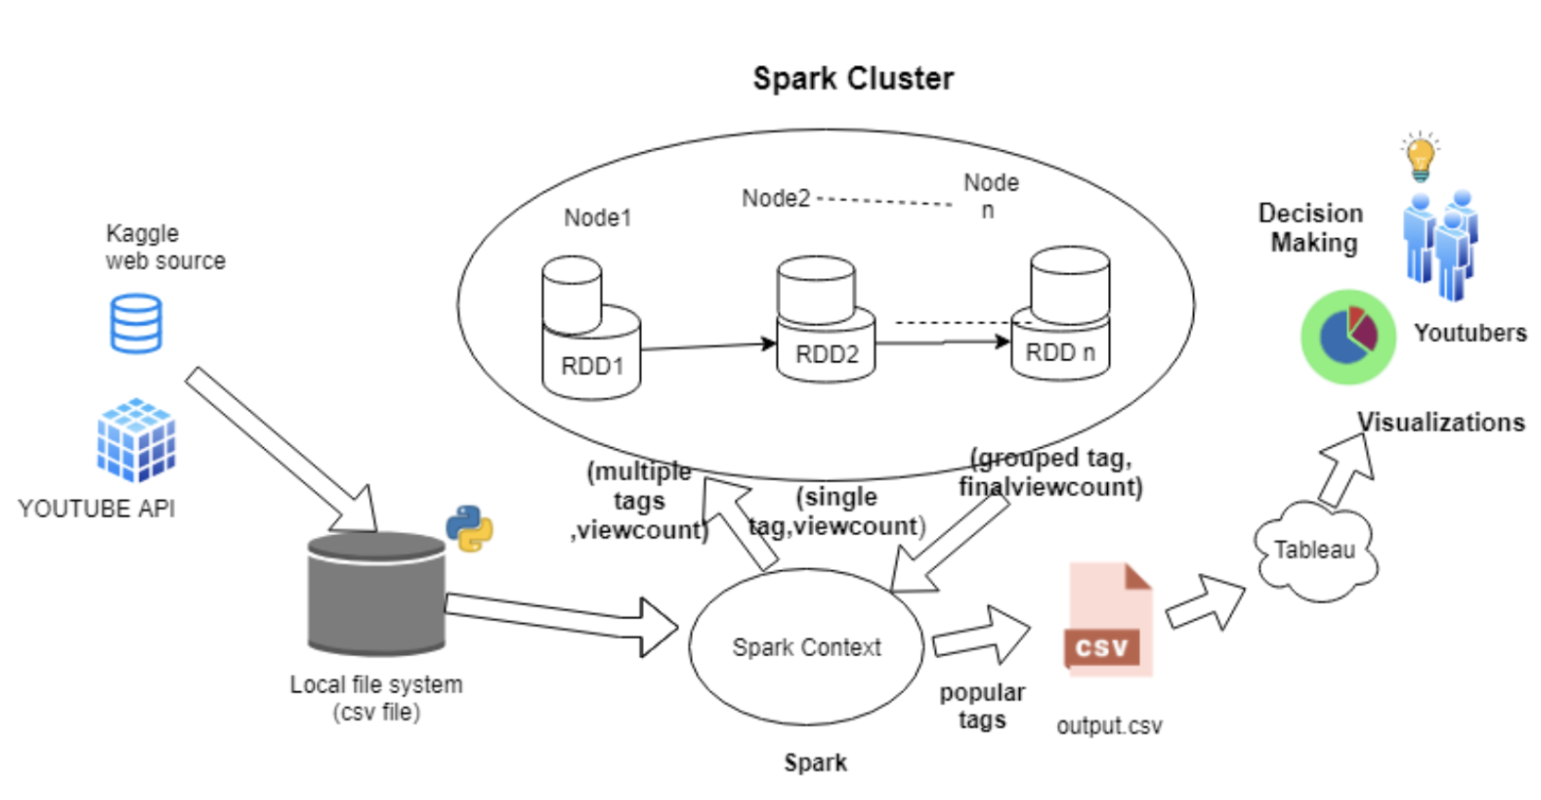
Data Pipeline for Tag Analysis

Slide 15
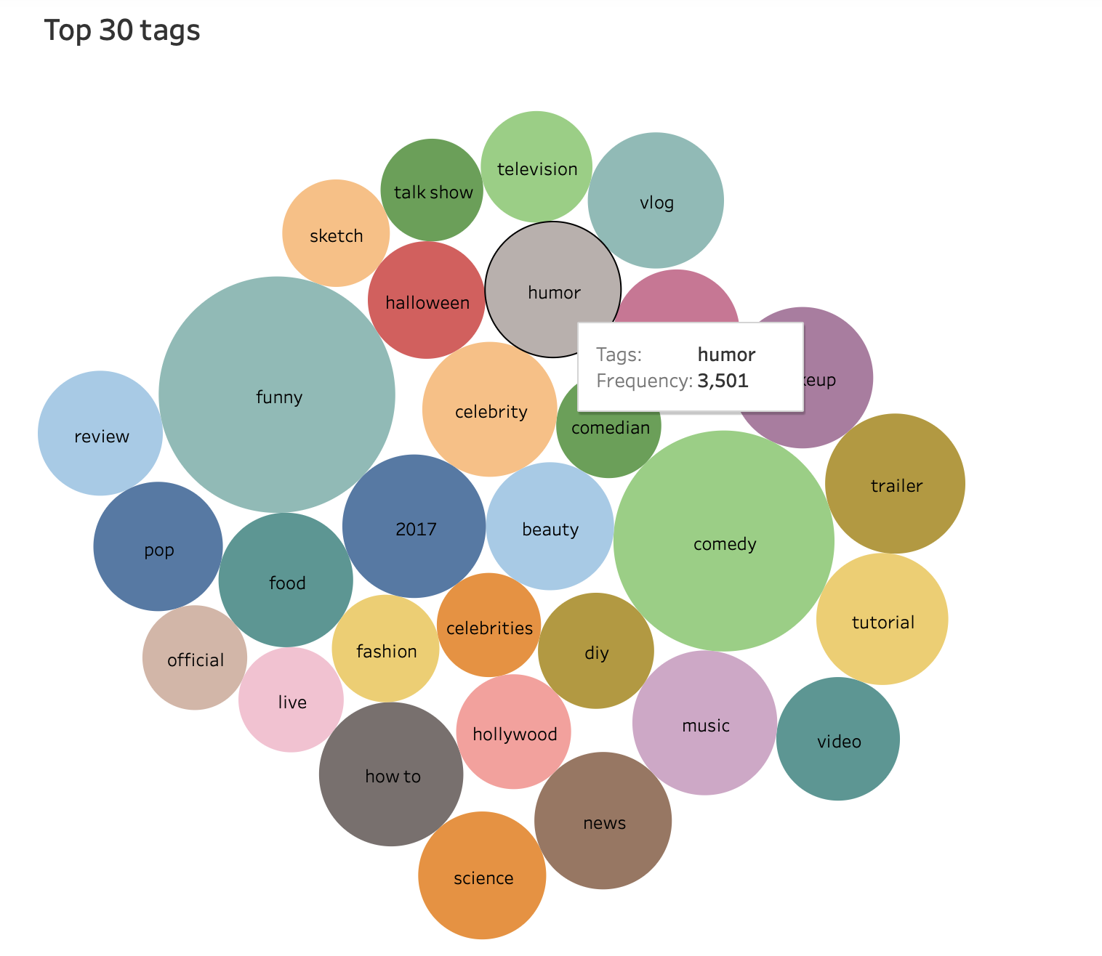
Tag Analysis results

Slide 16
Future SCOPe
Use of Youtube API instead of Kaggle dataset
Performing sentiment analysis with history
videos suggestion based on user comments
Auto tagging videos based on comments

Slide 17
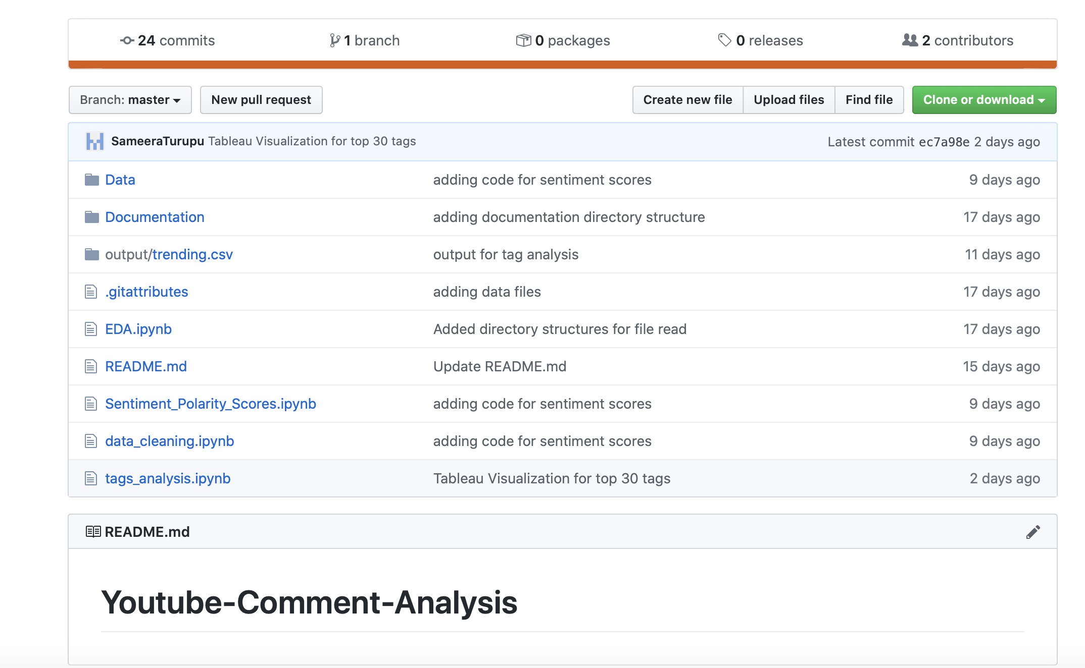
Github

Slide 18
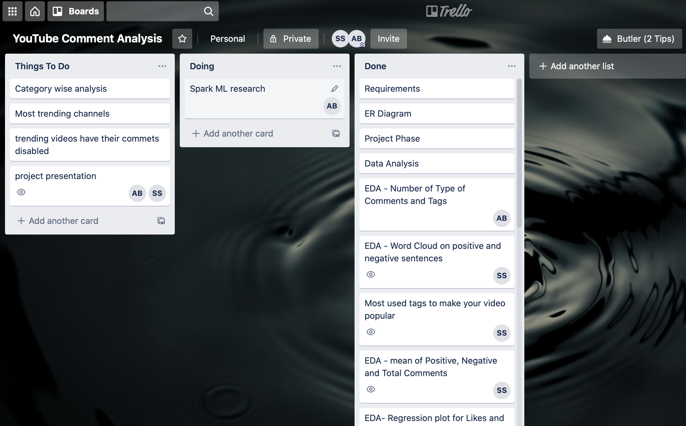
Trello
Board

Slide 19
Thank You

